Slide 1

Analysing Traffic Incidents
Text Processing | Sentiment Analysis of Twitter Data

Slide 2
01
Problem Statement
02
Objective
TABLE OF CONTENTS
03
Methodology
04
Result Analysis
05
Further Exploration
06
Conclusion

Slide 3
PROBLEM STATEMENT
PROBLEM STATEMENT
Road traffic congestion is one of the most significant problems in the world as the population burgeons with time, especially in larger cities. In Singapore, accidents and traffic congestion have increased in many major roads due to increasing number of vehicles at any point of time.

Slide 4
PROBLEM STATEMENT
PROBLEM STATEMENT
Twitter has emerged as an important source of information on various topics including road traffic. A large number of tweets are posted every day by LTA Traffic News twitter account as it aim to inform their followers about traffic conditions.

Slide 5
PROBLEM STATEMENT
PROBLEM STATEMENT
To minimize traffic related problem, it is very necessary to monitor traffic in real time so that we can recognize the areas that are of high traffic to optimise travel journey as well as to reduce any potential traffic accidents due to congestion.

Slide 6
OBJECTIVE
ABOUT THE PROJECT
In this project, I would like to explore a methodology for preprocessing and analyzing real time traffic related incident tweets from LTA Traffic News twitter account as well as ideating ways to inculcate the corresponding real time road traffic camera images and pinpoint precise location of traffic conditions.

Slide 7
METHODOLOGY
Data Collection Scraping | Preparation | Cleaning
Data Exploration Exploratory Data Analysis
Sentiment Analysis Serious | Non-Serious
Natural Language Programming Tokenization | Stop Words Filtering | Stemming | Stemming Filtering
Further Exploration
Geolocation | Traffic Camera Images

Slide 8
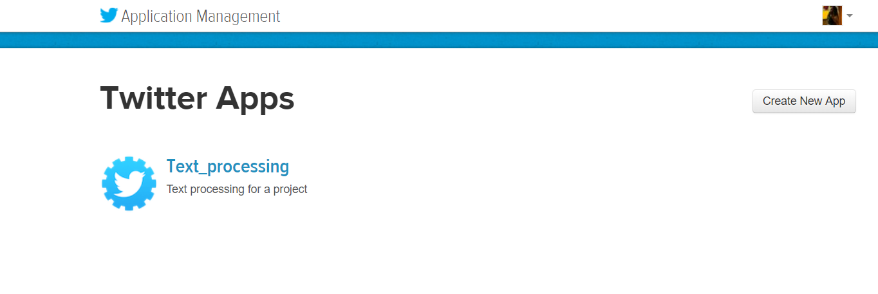
DATA COLLECTION
Extract Data from Twitter
3222 tweets from @LTATrafficNews
systemically backdated from 3th February 2020 12pm

Slide 9
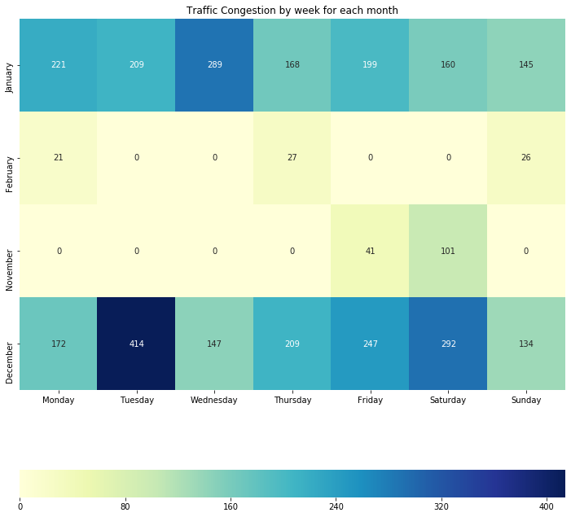

Which days are road traffic incidents most likely to occur?
EXPLORATORY DATA ANALYSIS
TUESDAYS IN THE MONTH OF DECEMBER
414
highest traffic incidents reported in an day of week

Slide 10
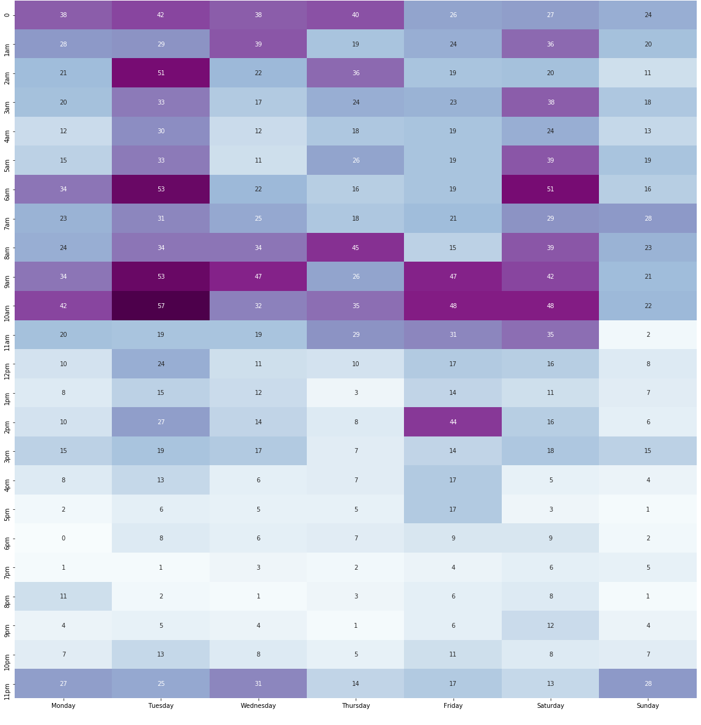
What timings are road traffic incidents most likely to occur?
EXPLORATORY DATA ANALYSIS
BEFORE 10 AM esp on Tuesdays and Thursdays
57
highest traffic incidents reported in an hour

Slide 11
DATA CLEANING
remove html tags
replace blank spaces
remove unnecessary punctuation
convert datetime
remove links
remove tabs
remove special characters
apply month mapping

Slide 12
PREPROCESSING
Removal of Punctuations
Removal of Stopwords
Normalization

Slide 13
SENTIMENT ANALYSIS
Sentiment Analysis
By applying Sentiment Analysis to the traffic incident data, I hoping to achieve a better understanding respect to the polarity of the each tweet in terms of seriousness or non-seriousness

Slide 14
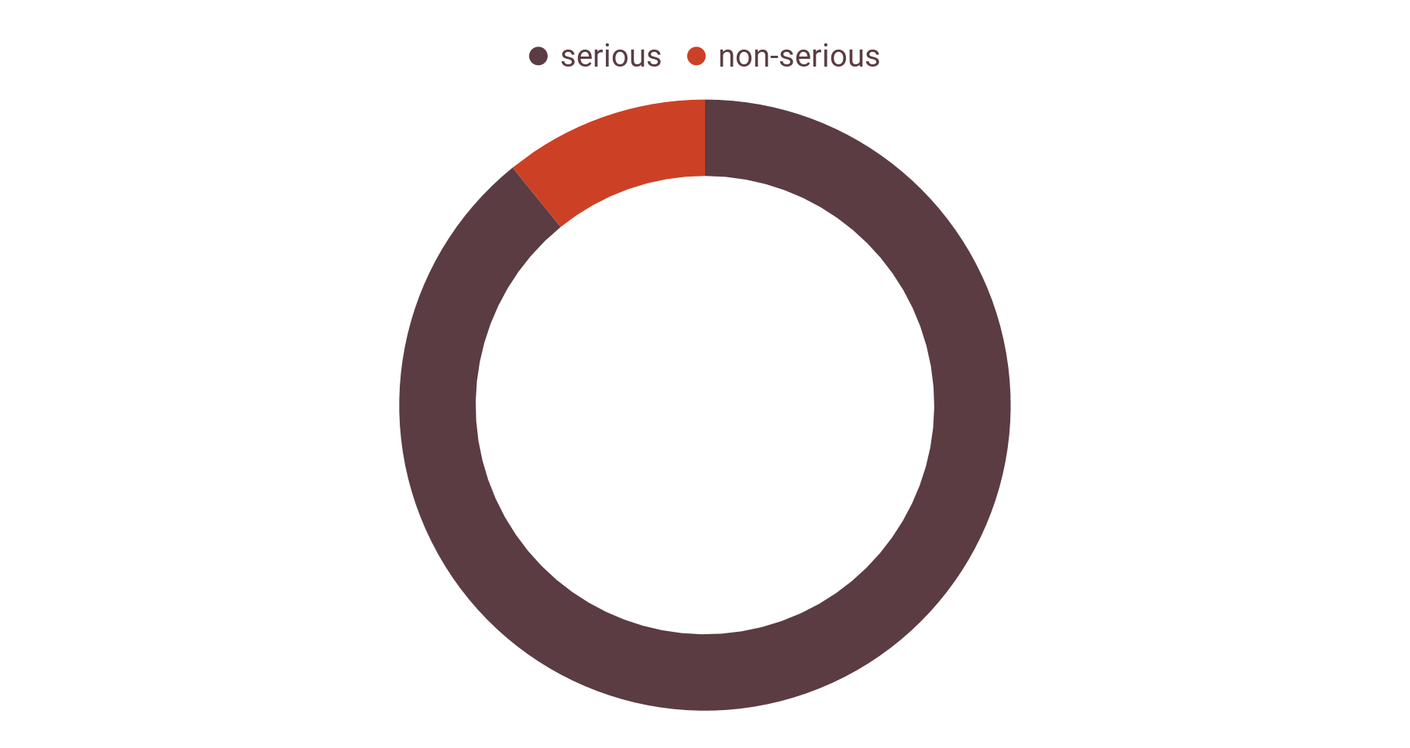
SENTIMENT ANALYSIS
Using VADER Sentiment Analysis
a lexicon and rule-based sentiment analysis tool that is specifically attuned to sentiments expressed in social media

Slide 15
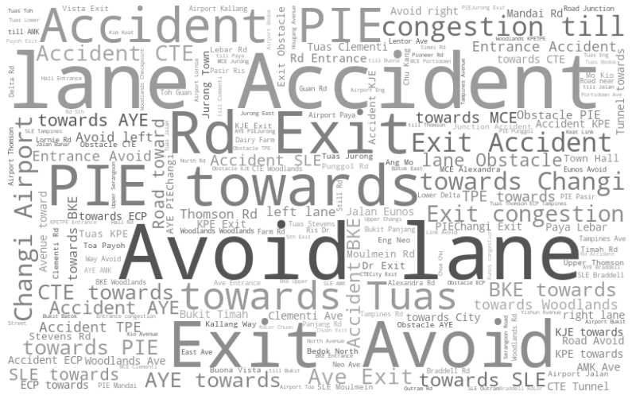
Serious Sentiment
SENTIMENT ANALYSIS
Notes:
We can see that for Serious Tweets, words like Accident, Avoid Lane, Obstacle indicating the action/results and PIE and Tuas seems to be the most common location for serious (negative) tweets to be surrounding around.

Slide 16
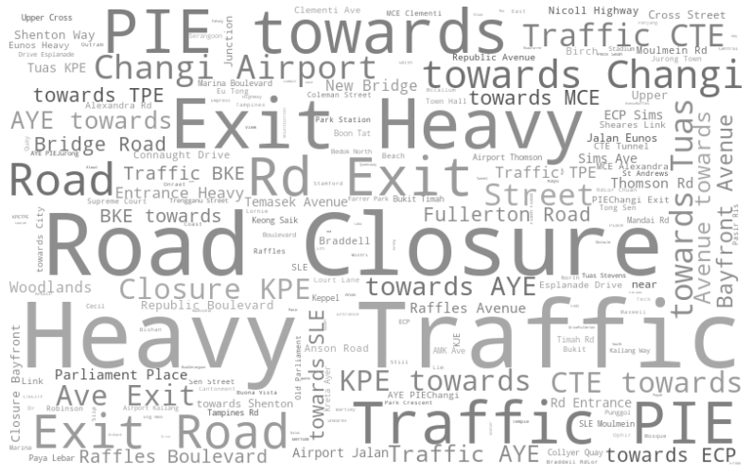
Non-Serious Sentiment
SENTIMENT ANALYSIS
Notes:
We can see that for Non-Serious Tweets, words like Heavy Traffic, Road Closure indicating the action/results and PIE seems to be the most common location for non-serious (positive) tweets to be surrounding around.

Slide 17
FEATURE EXTRACTION + MODELLING
FEATURE EXTRACTION + MODELLING
Bag of words
Simple vectorization
TF-IDF
simple Naive Bayes model
Term Frequency - Inverse Document Frequency
key-words based features
key-phrases based features for both BOW word and TF-IDF word features

Slide 18
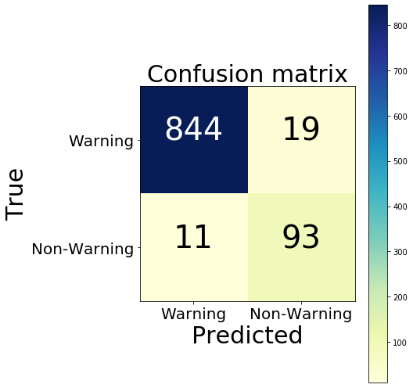

Predictions on 'key-words' based features
CONFUSION MATRIX
Accuracy Score = 0.969
Accuracy Score = 0.971

Slide 19
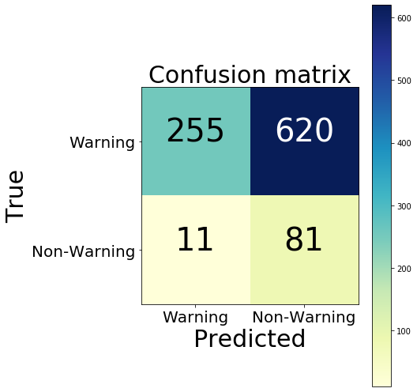
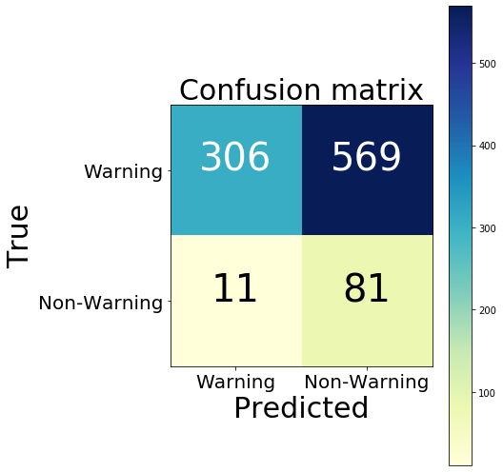
Predictions on 'key-phrases' based features
CONFUSION MATRIX
Accuracy Score = 0.347
Accuracy Score = 0.400

Slide 20
SNEAK PEEK
Based on comparing accuracy scores, predictions on 'key words' based features performed better than on 'key phrase' based features. And TF-IDF performed better than BOW though the difference were slight. Therefore, I am proceeding with TF-IDF as a vectorizer using prediction on 'key words' based features

Slide 21
THANKS

